Slide 1
Art

Slide 2

Art engages, inspires and challenges pupils, equipping them with the knowledge and skills to experiment and invent.

Slide 3
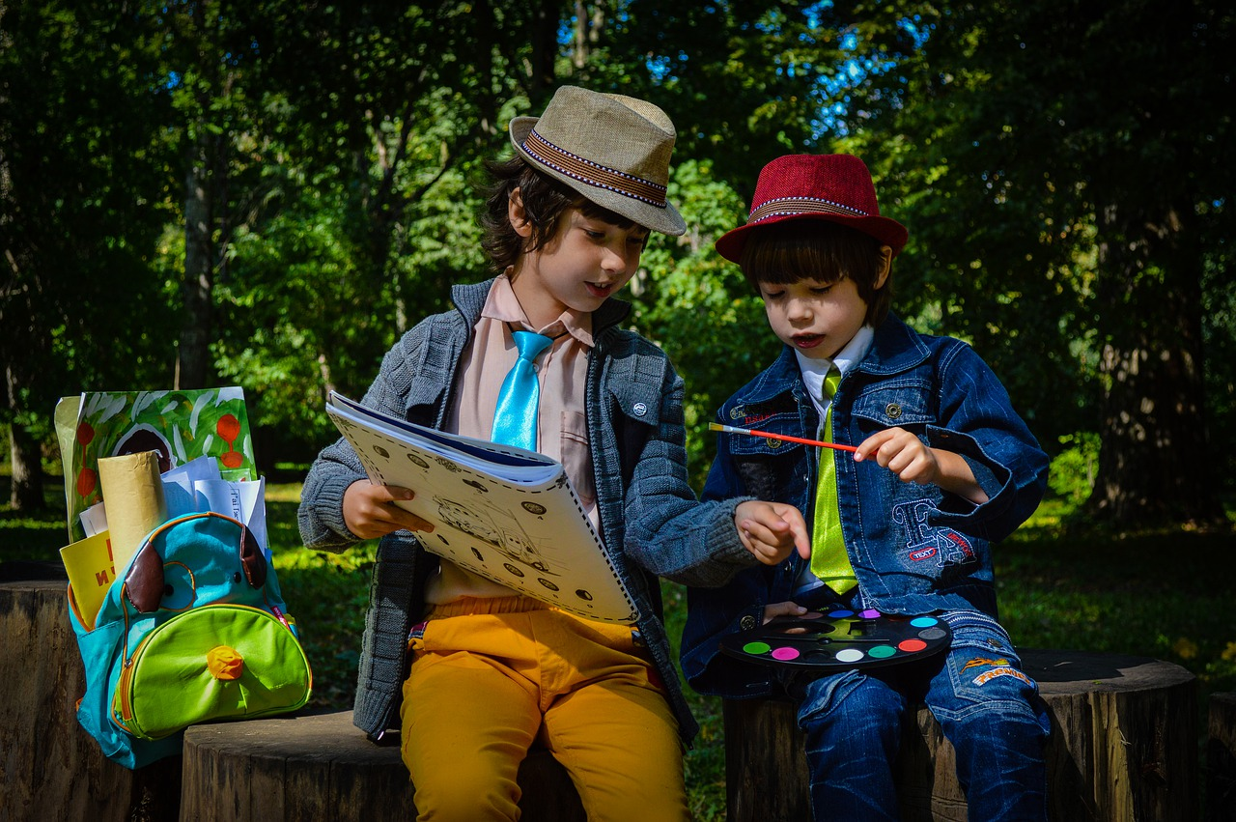
Art is an important part of developing pupils’ ability to express their individual creativity, working both individually and collaboratively with others.

Slide 4

Art takes pupils to other worlds, cultures and times, as they explore ideas in the work of a variety of artists.

Slide 5
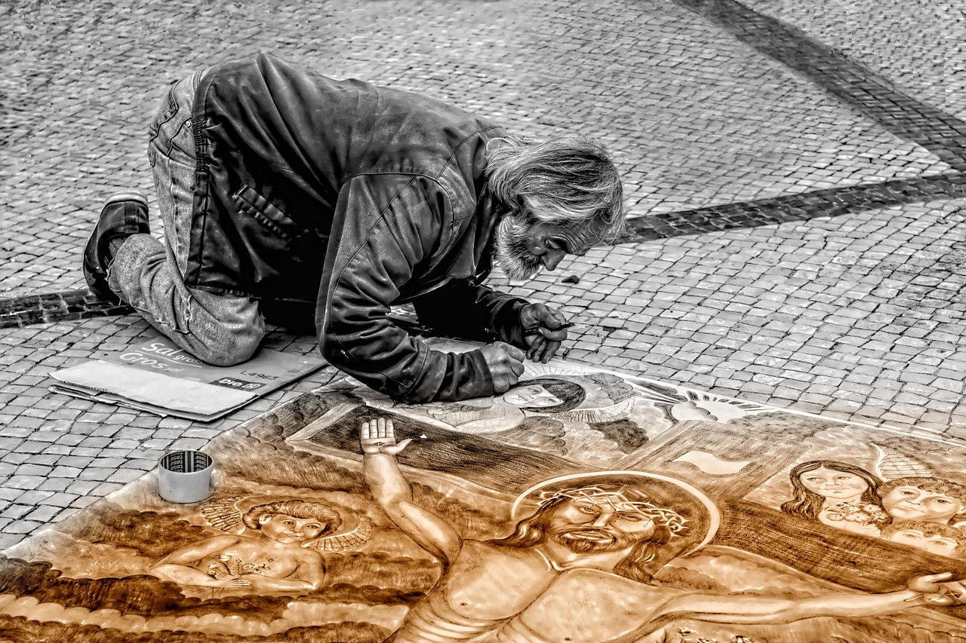
Through art, pupils produce their own, original creative work, exploring their ideas and recording their experiences.

Slide 6
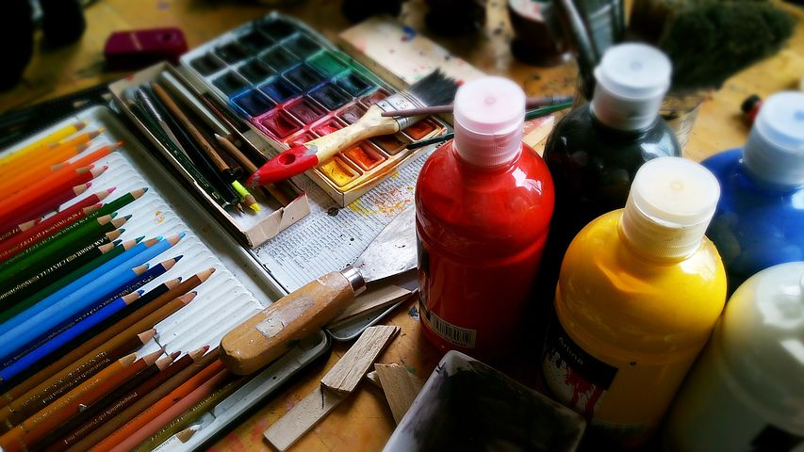
Learning through art develops pupils’ language skills, social skills, decision-making and
risk-taking.

