Slide 2
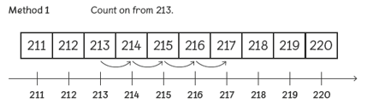
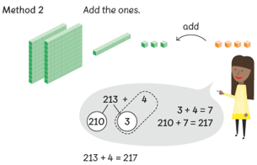
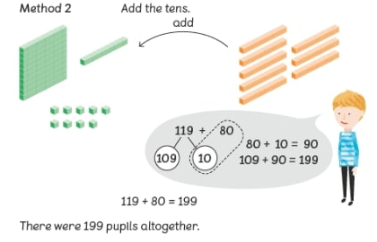
Reinforce addition from Year 2 using concrete
resources to add ones, tens and hundreds.
‘Cherry’ method is used
to partition and add.

Slide 5
Year 3
Subtract numbers with 3 digits

Slide 6
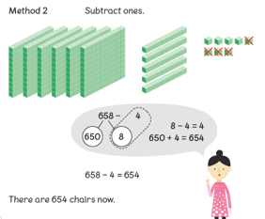
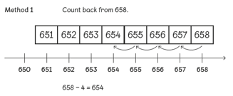

Slide 7
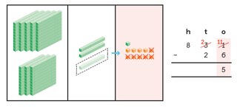

Slide 8
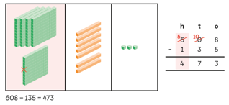

Slide 9
Year 3
Multiply 2-digits by a single digit number

Slide 10
Times Tables
Year 3 Expectations
Count from 0 in multiples of 4, 8, 50,100
Recall and use multiplication and division
facts for the 3, 4 and 8 times tables

Slide 13
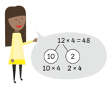
Partitioning can also be
shown using the
‘cherry’ method.

Slide 14
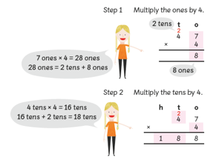
Move onto column method. When regrouping, write on top of the next digit.

Slide 15
Year 3
Divide 2-digit numbers by a single digit number (where there is no remainder in the answer)

Slide 16
